Slide 1
Development Platform and Containerization
Eric Müllenbach - Thales

Slide 2


About me
Eric Müllenbach
Working since more than 10 years for Thales, specialized in three disciplines:
Cloud Ease cloud adoption inside Thales: Build easy to use components and help to use them
Security Security is everyone's job: Make them care
Innovation Look a bit above the edge: Where can we be in five years?

Slide 3
Our agenda
Friday 4
Friday 11
Saturday 5
Saturday 12
General Introduction, Docker, Kubernetes, Distributed Development
Project Day 1
DevSecOps
Project Day 2

Slide 4
Day 1
General Introduction, Docker, Kubernetes, Distributed Development

Slide 5
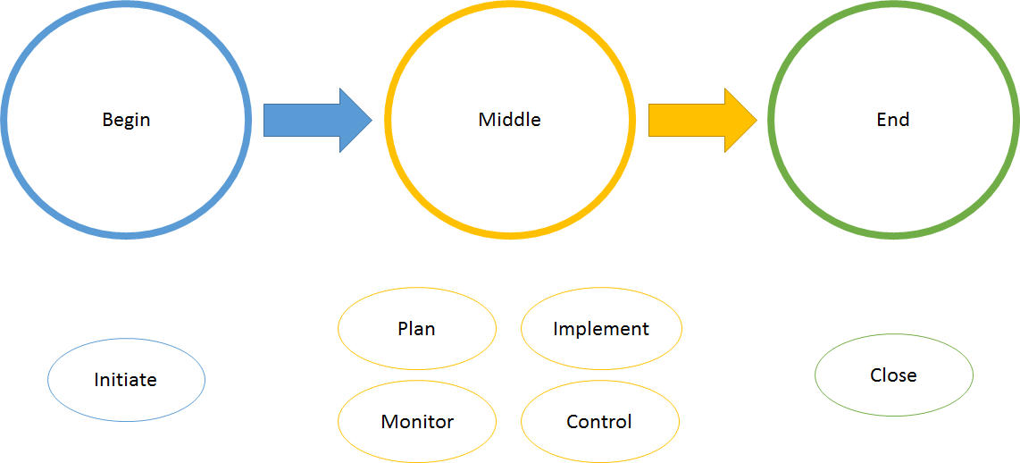
What’s a project?

Slide 6
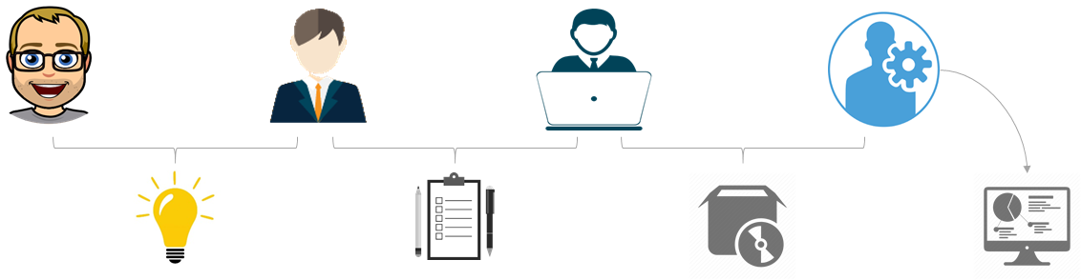
How can we apply this?

Slide 7
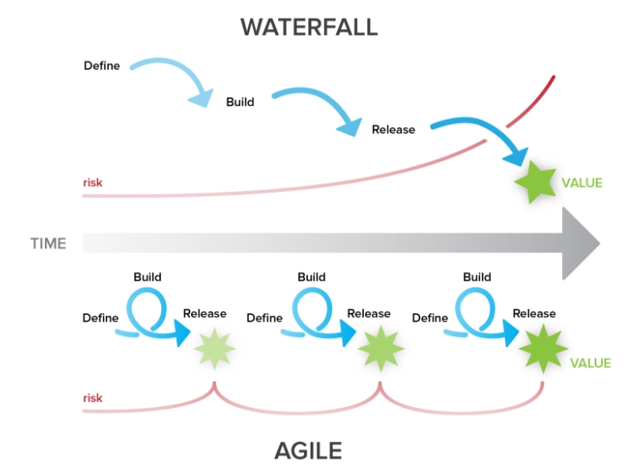
Scrum and Waterfall

Slide 8
What people are saying
I want my features delivered yesterday!
Peter Prod, Product Manager
I want to see my changes in production right away
Daisy Dev, Developer
I want a stable system that doesn’t wake me up at 2 in the morning
Olaf Ops, Operations

Slide 9
What about Security?
Despite all the needs of the different actors, Security is a continuous activity that must be performed at all stages of the Software Lifecycle
Least privilege
Reduce attack surface
Defence in depth

Slide 10
Continuous Integration
Maintain a Single Source Repository
Automate the Build
Make Your Build Self-Testing
Everyone Commits To the Mainline Every Day
Every Commit Should Build the Mainline on an Integration Machine
Fix Broken Builds Immediately
Keep the Build Fast
Test in a Clone of the Production Environment
Make it Easy for Anyone to Get the Latest Executable
Everyone can see what's happening
Automate Deployment

Slide 11
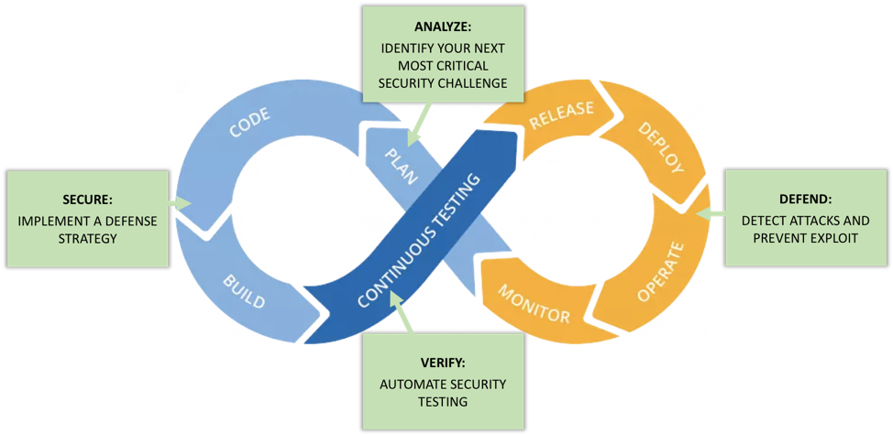
Dev (Sec) Ops

Slide 12
Exercise
https://3r1.co/cd
1.1
Setup your environment

Slide 13
Microservice Architecture
Monolith
Microservices

Slide 14
Microservice Architecture - Criteria
Elastic
A micro-service must be able to scale, up or down, independently of other services in the same application.
Resilient
A microservice must fail without impacting other services in the same application.
Bounded
A micro-service must offer an interface that is uniform and is designed to support service composition through contracts.
Complete
A micro-service must be functionally complete, with a well defined contract, trying to avoid inter-services dependencies.
Minimal
A micro-service must only contain highly cohesive entities

Slide 15
Microservice Architecture - Main criterion is decoupling!
Implements separated and independent functionalities
One feature is one change
in one micro-service
and therefore one deployment
Micro-services are intended to:
Be developed & tested…
Be deployed & updated…
Be operated…
Scale & fail…
…independently !

Slide 16
Microservice Architecture - Coupling mitigation?
Teams shall monitor coupling and identify mitigations
Architecture mitigations
Share nothing, limit inter-service communication, Domain Driven Design
Organizational mitigations
One team accountable of N services
Implementation mitigations
Built-in resilience, inner-source management

Slide 17
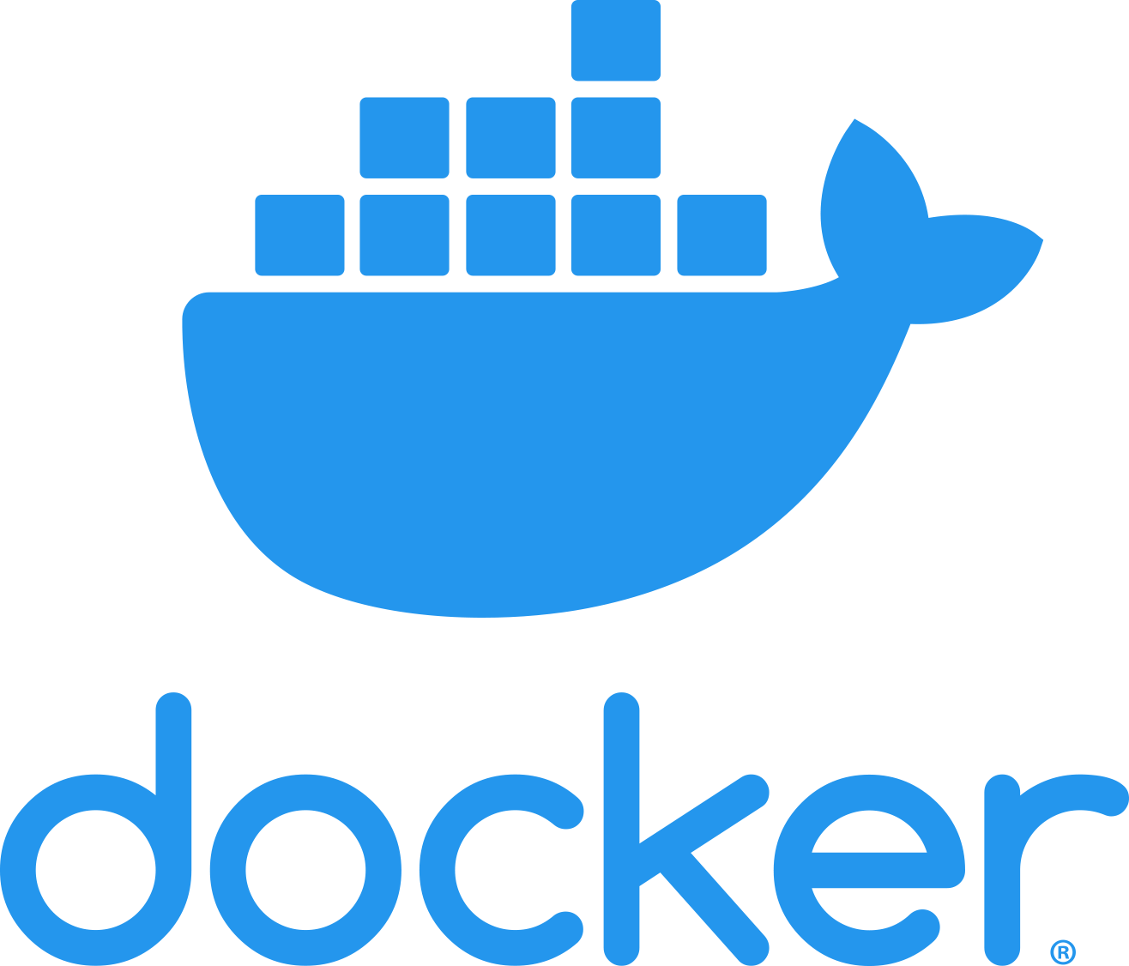
Cloud Technologies - Docker
Standard for application packaging (Containerization)
Application is packaged with all its dependencies, allowing seamless deployment in different environments
Container
Container
Container
Container
Container Engine
App
Libs
Container OS
Guest Operating System
Hypervisor
Host Operating System
Infrastructure

Slide 18
Exercise
https://3r1.co/cd
1.2
Docker Lab

Slide 19
Container Orchestration
The Lifecycle of an application is a difficult task
Container Management is a discipline that evolved heavily over the last years
There are two market leaders:
Kubernetes
AWS ECS

Slide 20

Kubernetes
Kubernetes is an open-source container orchestration system for automating application deployment, scaling, and management.
Originally designed by Google, now maintained by the Cloud Native Computing Foundation.
Aims to provide a "platform for automating deployment, scaling, and operations of application containers across clusters of hosts".

Slide 21

Cloud Technologies - Kubernetes
De-facto standard for Container deployment and orchestration in different private and public Clouds
Alternatives: Docker Compose/Stack , Docker Swarm, Hashicorp Nomad, Mesophere
With orchestration, we understand
Healthcheck
Load Balancing
Autoscaling
Container
Container
Container
Container
Container
Container
Container
Container
Container
Container Engine
Container Engine
Container Engine
Guest Operating System
Guest Operating System
Guest Operating System
Hypervisor
Hypervisor
Hypervisor
Host Operating System
Host Operating System
Host Operating System
Infrastructure
Infrastructure
Infrastructure

Slide 22
Cloud Technologies - Kubernetes
Kubernetes
Is responsible to orchestrate
Not to run containers ( it counts on Docker engine or other container engines)
Service
Pod
Pod
Container
Container
Container
Container
Container Engine
Container Engine
Container Engine
Guest Operating System
Guest Operating System
Guest Operating System
Hypervisor
Hypervisor
Hypervisor
Host Operating System
Host Operating System
Host Operating System
Infrastructure
Infrastructure
Infrastructure
Worker Node
Worker Node
Worker Node

Slide 23
Exercise
https://3r1.co/cd
1.3
Kubernetes Lab

Slide 24
Version Control System
It is always advantageous to have a version history of changes in your source code or configuration files
Several systems exist:
Git
Mercurial
Subversion
We will use Github as the hosting platform for our Sourcecode, managed with Git

Slide 25
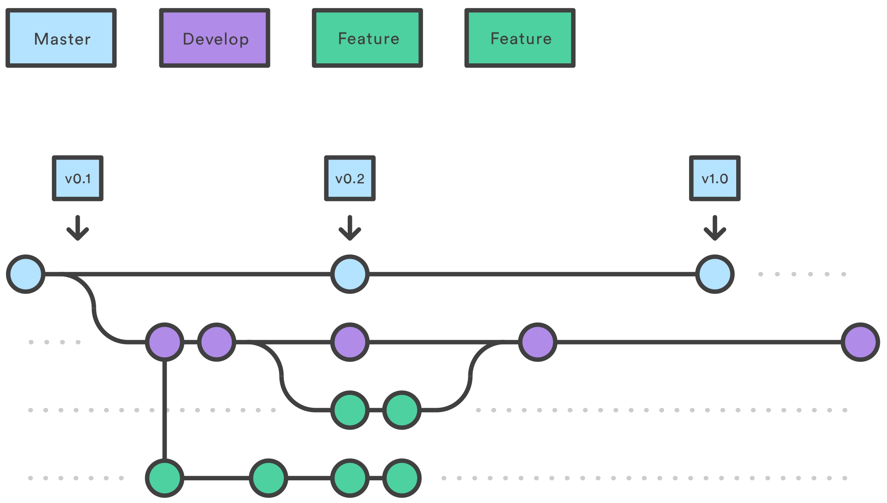
Gitflow example

Slide 26
Exercise
https://3r1.co/cd
1.4
Github Setup

Slide 27
What’s a build server?
A build server is a tool that enables Continuous Integration
an excellent practice to follow when developing software
Build servers are commonly referred to as continuous integration servers or simply CI servers
There are a number of open source and commercial options available in this category of tools, and you can write your own simple build server as just a script that is able to detect when an update has been made to Version Control, and triggers a build as a result.

Slide 28
Build Server examples
Travis CI
Circle CI
AWS Code Build
Jenkins
Github Actions

Slide 29
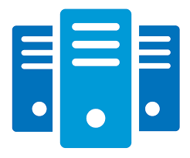

Build Pipeline Example
Source
Code
Continuous Integration (CI)
Checkout
Compile
Unit tests
Package
SAST
Image build
Anti virus
Continuous Delivery (CD)
Deliverable
Test environment Setup
Integration tests
execution
Test coverage analysis
Notes:
That‘s our CI pipeline, nothing special, won‘t explain CI/CD/DevOps

Slide 30
Pipeline as Code
Teams are pushing for automation across their environments, including their development infrastructure.
Pipelines as code is defining the deployment pipeline through code instead of configuring a running CI/CD tool

Slide 31
Exercise
https://3r1.co/cd
1.5
Github Actions

